Slide 1






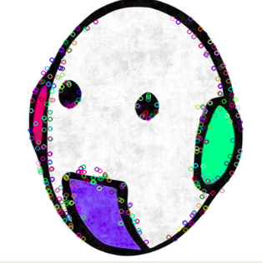
Automatic Segmentation of
COVID-19 from CT images
Instructor: Prof. Fabrice MERIAUDEAU
Prof. Abdul QAYYUM
Ali, Mahmoud Ahmed Mohamed

Slide 2
Outlier
Introduction
Problem
Objective
Dataset
Solution Models
U-net
Linknet
FPN
PNPnet
Results
Evaluation of Result
References
1

Slide 3
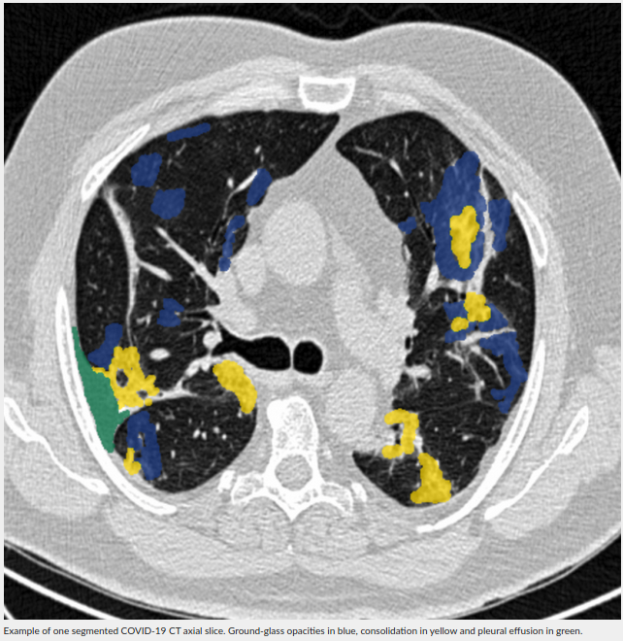
Introduction
The coronavirus disease (COVID-19) is an infectious disease caused by a new strain of coronavirus.
This new virus and disease were unknown before the outbreak began in Wuhan, China, in December 2019.
This virus directly causes respiratory diseases, and this appears in the lungs.
This virus has claimed many lives around the world and until now
2
http://medicalsegmentation.com/covid19/

Slide 4
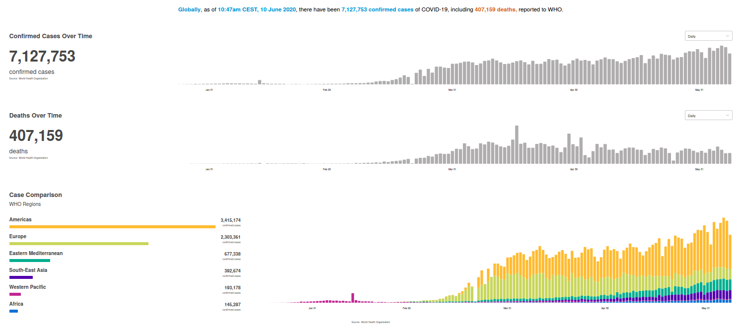
COVID-19 World
3
https://covid19.who.int/?gclid=Cj0KCQjwiYL3BRDVARIsAF9E4Ge9aCQDmghQHgudMO3Ekl67iJas0KIwvqG3YeInip2tuXChmMgOjYsaAkTWEALw_wcB

Slide 5
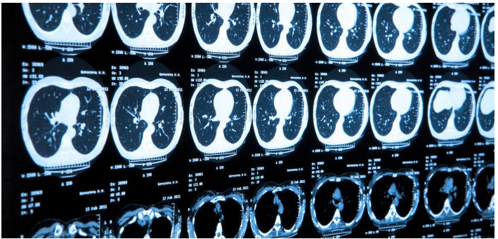
Problem :
For COVID-19 patients the common stage in diagnosis is computer tomography (CT).
A radiologist is often asked to estimate the extent of damage with respect to lung volume.
It is a time-consuming procedure, because radiologist should look through all axial slices on CT and segment each of them.
4
https://news.feinberg.northwestern.edu/2019/05/artificial-intelligence-system-spots-lung-cancer-before-radiologists/

Slide 6
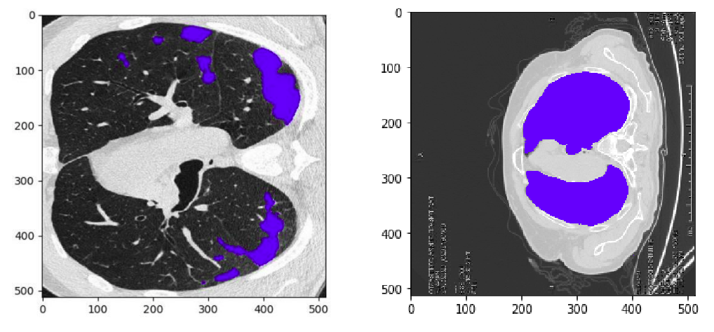
Objective
Automatic Segmentation using Artificial intelligence to:
Left Lung
Right Lung
COVID-19 in CT images.
Determine the location of diseases and the rate of occurrence in the lung.
5
https://www.linkedin.com/groups/13845976/ [Datathon DATACARE-COVID19]

Slide 7
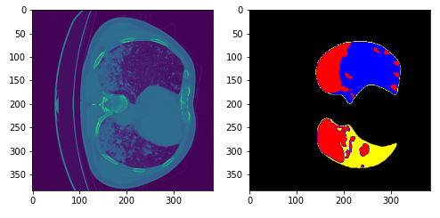
Dataset:
20 lung CT scans from for Lung.
Annotations to: 1- left lung. 2- right lung. 3- infections.
6

Slide 8
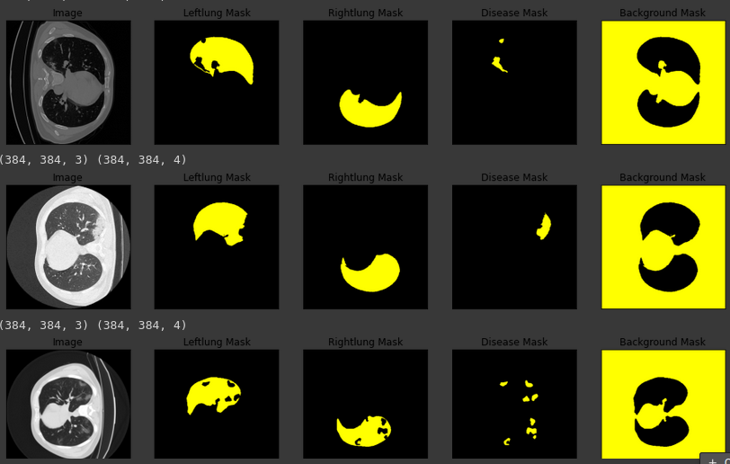
Sample of Dataset :
7

Slide 9
Solution
There are several techniques used in the left ventricle segmentation.
Techniques | Methods
Image based methods | Thresholding , Region growing
Pixel Classification methods | Clustering, Classification
Deformable models | Active contour model
model based methods | Active shape model [ASM], Active appearance model [AAM]
8

Slide 10
Segmentation Methods
Let's focus on this method:
Techniques | Methods
Image based methods | Thresholding , Region growing
Pixel Classification methods | Clustering, Classification
Deformable models | Active contour model
model based methods | Active shape model [ASM], Active appearance model [AAM]
9

Slide 11
Segmentation Models [Deep Learning]:
Pixel Classification methods
DL
U-Net
FPN
PSP-Net
Link-Net
10

Slide 12
Deep learning method (U-net)
It had been quite successful in biomedical segmentation tasks. U-net models are promising, as the authors were able to train their network with only 30 images by using aggressive image augmentation combined with pixel-wise reweighting. (Interested readers: here are reviews for CNN and conventional approaches.)
The U-Net architecture is built upon the Fully Convolutional Network and modified in a way that it yields better segmentation in medical imaging.
1
11

Slide 13
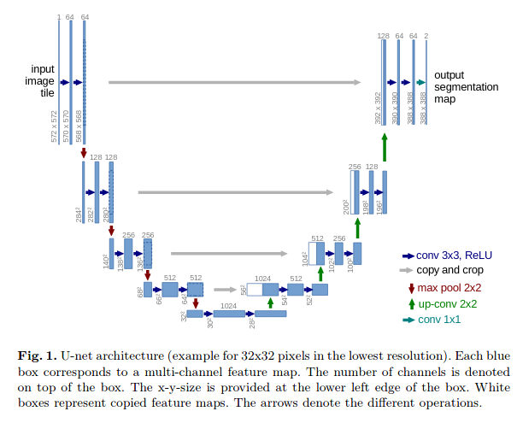
U-net (Cont.)
U-Net architecture is separated in 3 parts: 1 : The contracting/downsampling path 2 : Bottleneck 3 : The expanding/upsampling path
12
https://arxiv.org/pdf/1505.04597.pdf

Slide 14
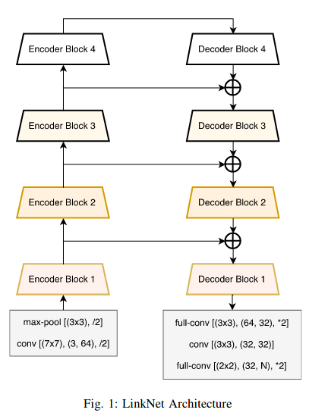
Linknet:
Deep neural network architecture which allows it to learn without any significant increase in number of parameters.
Efficient algorithm in real-time application.
13
https://arxiv.org/pdf/1707.03718.pdf

Slide 15
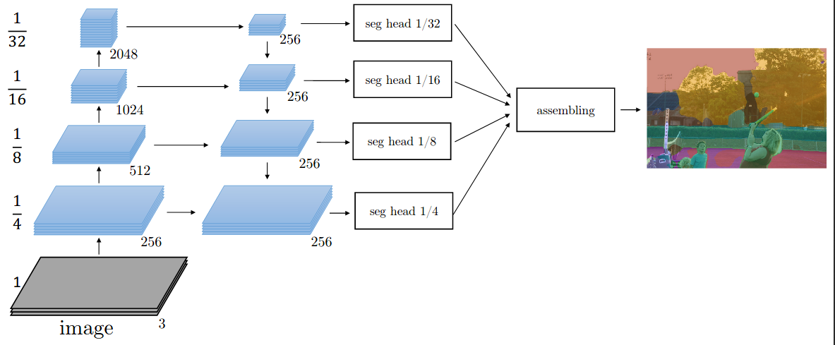
Feature Pyramid Network(FPN)
Feature pyramids inside the convolutional neural network (CNN).
It combines low-resolution, semantically strong features with high-resolution, semantically weak features via a top-down pathway and lateral connections.
Feature pyramid has rich semantics at all levels and is built quickly from a single input image scale, thereby without sacrificing representational power, speed, or memory.
1
14
http://presentations.cocodataset.org/COCO17-Stuff-FAIR.pdf
Notes:
2.1. Bottom-Up Pathway
The bottom-up pathway is the feedforward computation of the backbone ConvNet. It is defined that one pyramid level is for each stage. The output of the last layer of each stage will be used as the reference set of feature maps for enriching the top-down pathway by lateral connection.
2.2. Top-Down Pathway and Lateral Connection
The higher resolution features is upsampled spatially coarser, but semantically stronger, feature maps from higher pyramid levels. More specifically, the spatial resolution is upsampled by a factor of 2 using the nearest neighbor for simplicity.
Each lateral connection merges feature maps of the same spatial size from the bottom-up pathway and the top-down pathway.
Specifically, the feature maps from bottom-up pathway undergoes 1×1 convolutions to reduce the channel dimensions.
And the feature maps from the bottom-up pathway and the top-down pathway are merged by element-wise addition.
2.3. Prediction
Finally, a 3×3 convolution is appended on each merged map to generate the final feature map, which is to reduce the aliasing effect of upsampling. This final set of feature maps is called {P2, P3, P4, P5}, corresponding to {C2, C3, C4, C5} that are respectively of the same spatial sizes.
Because all levels of the pyramid use shared classifiers/regressors as in a traditional featurized image pyramid, the feature dimension at output d is fixed with d = 256. Thus, all extra convolutional layers have 256-channel outputs.

Slide 16
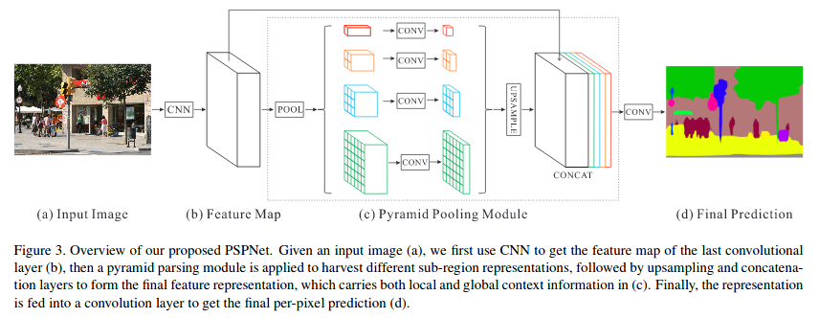
Pyramid Scene Parsing Network(PNPnet)
1
15
https://arxiv.org/pdf/1612.01105.pdf
Notes:
Gradient Magnitude and Largest eigenvalue -> The LV cavity appears bright and the myocardium that surrounds it appears dark. So, we need to improve edges that surround the LV cavity. Median filter -> The MRI provides high contrast between the blood and the myocardium, but there is gray inhomogeneites inside the LV cavity

Slide 17
Transfer learning
Transfer learning is a popular method in computer vision because it allows us to build accurate models in a timesaving way .
With transfer learning, instead of starting the learning process from scratch, you start from patterns that have been learned when solving a different problem.
Pretrain models | Trained on | # Parameters | Input | Output
U-Net | Imagenet Dataset | 10,115,948 | (256*256*3) | (256*256*4)
LinkNet |  | 6,096,780
FPN |  | 7,041,964
PSPNet |  | 1,770,854 | (384*384*3) | (384*384*4)
16

Slide 18
Train Models
Using Google colab and Kaggle Notebooks
Train models on [GPU]
# Epoch = 10
Pretrain models | Time of Train
U-Net | ~ 4.5 h
LinkNet | ~ 3.5 h
FPN | ~ 4 h
PSPNet | ~ 2 h
17

Slide 19
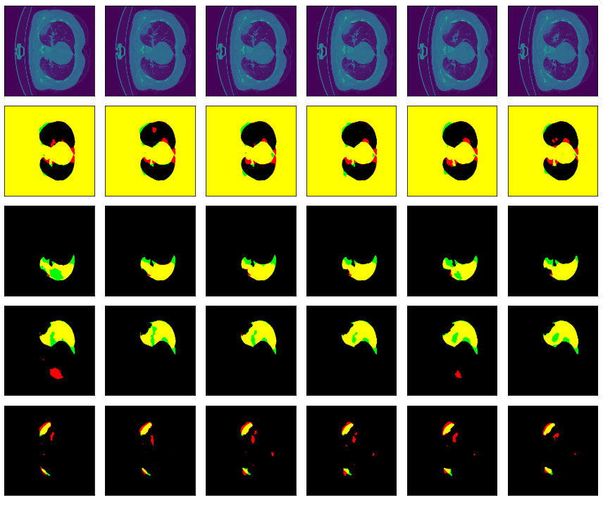
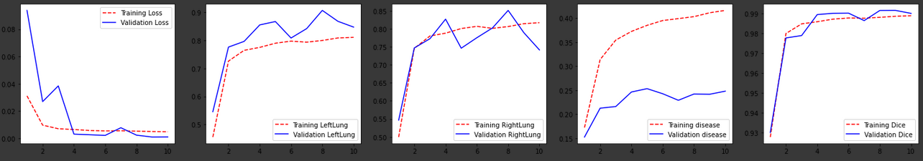
Results [U-net]
18

Slide 20
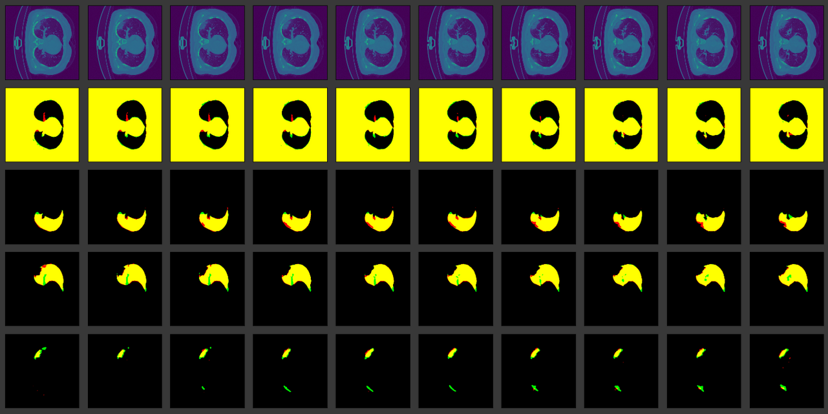
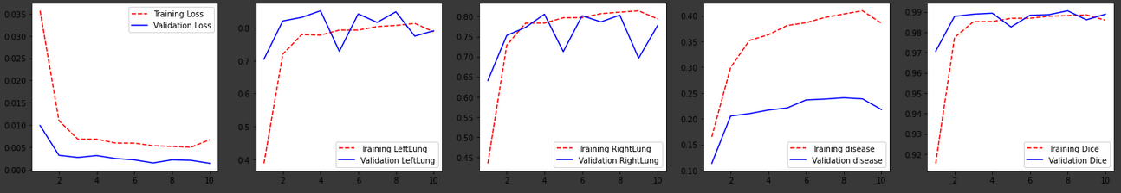
Results [Linknet]
19

Slide 21
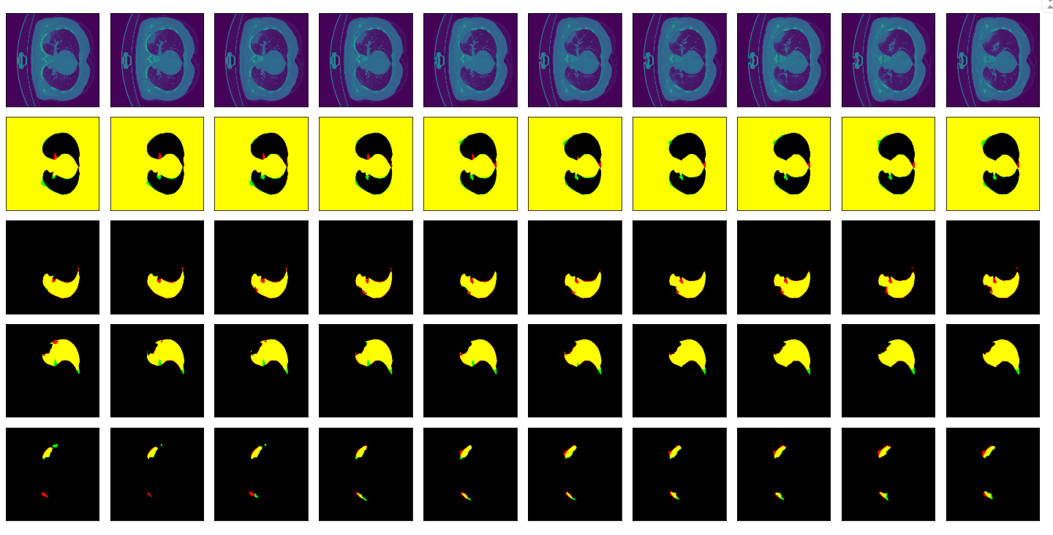
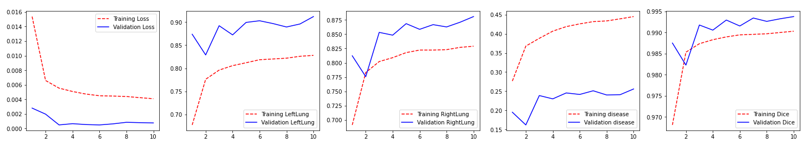
Results [FPN]
20

Slide 22
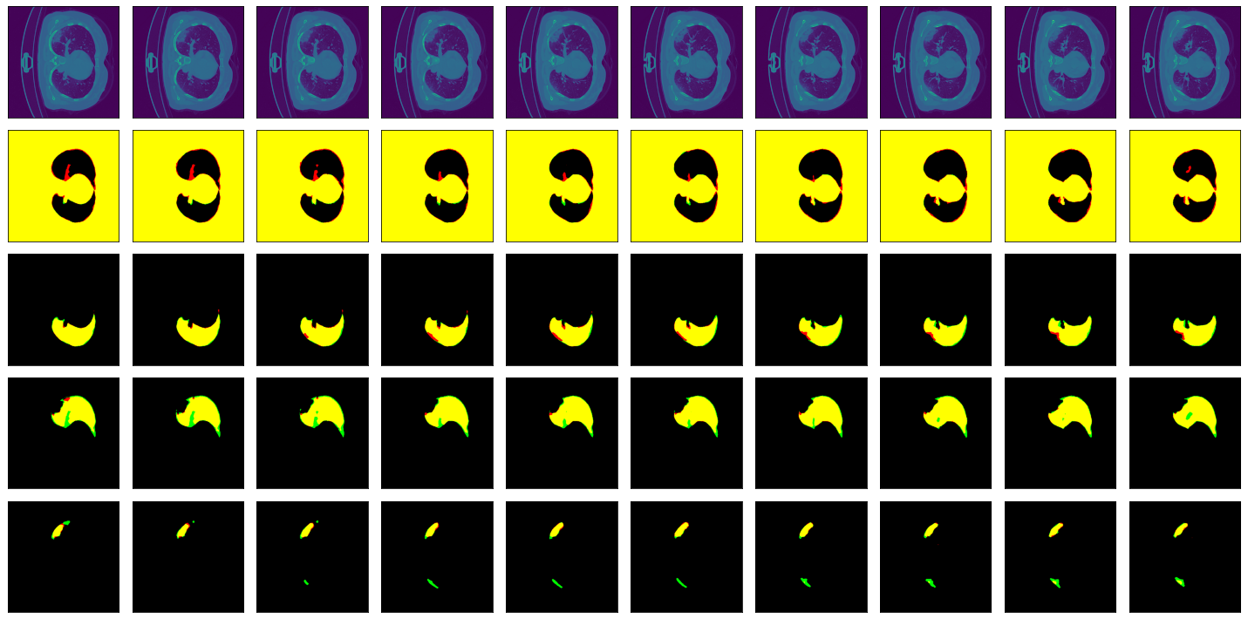
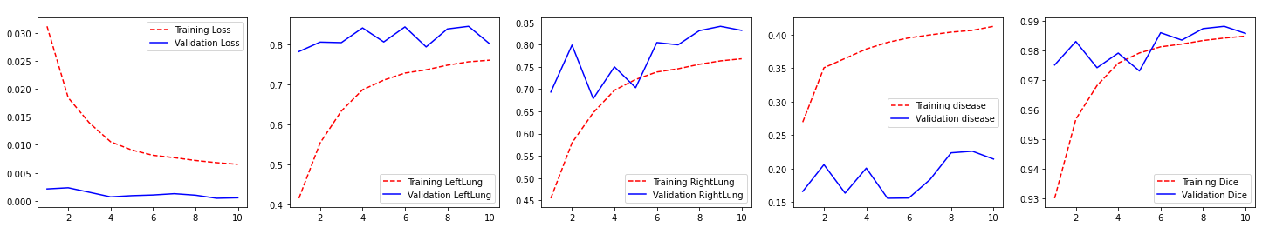
Results [PSPNet]
21

Slide 23
Evaluation:
To evaluate the work, we calculate different parameters that used to measure the performance of the segmentation algorithm. These parameters are sensitivity, specificity, and dice metric,..
Compared its values from the automatic segmentation algorithm, and the manual segmentation by different metric.
22

Slide 24
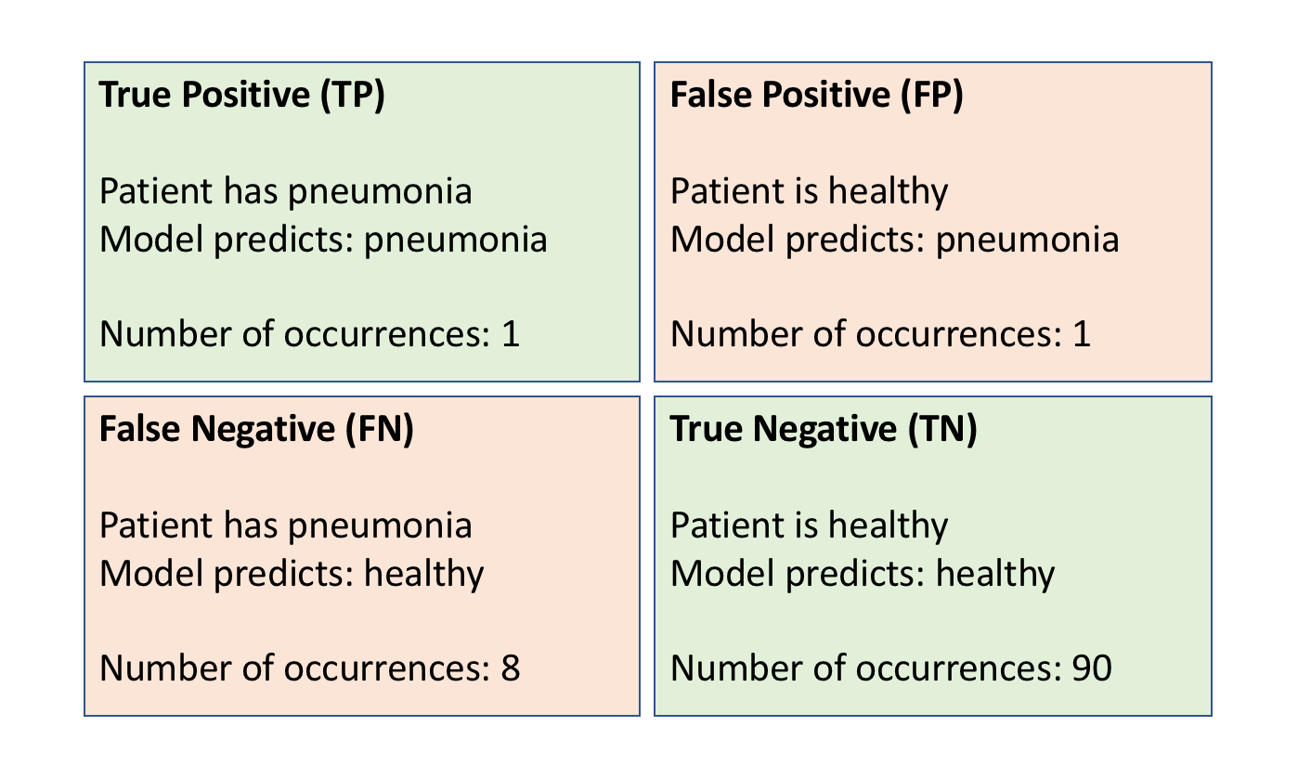
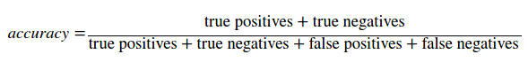
Evaluation(Accuracy):
23
https://training.mdfarragher.com/courses/machine-learning-tensorflow/lectures/5144634
Notes:
true positive (TP): The model classifies the example as positive, and the actual label also positive.
false positive (FP): The model classifies the example as positive, but the actual label is negative.
true negative (TN): The model classifies the example as negative, and the actual label is also negative.
false negative (FN): The model classifies the example as negative, but the label is actually positive.

Slide 25
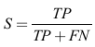
Evaluation (sensitivity)
The sensitivity is the proportion of true positives of the automatic segmentation output to the manual segmentation output (i.e. reference output).
24

Slide 26
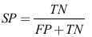
Evaluation (specificity)
The specificity is the proportion of true negatives of the automatic segmentation output to the manual segmentation output.
25

Slide 27
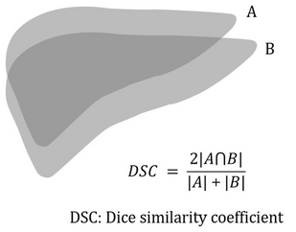
Evaluation (Dice Function)
Dice similarity coefficient, which is a measure of how well two objects overlap.
The Dice index ranges from 0 (complete mismatch) To 1 (perfect match).
26
https://www.researchgate.net/figure/Calculation-of-the-Dice-similarity-coefficient-The-deformed-contour-of-the-liver-from_fig4_328671987

Slide 28
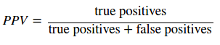
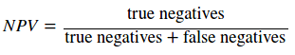
Evaluation(Positive predictive value (PPV))
Evaluation(Negative predictive value (NPV))
Positive predictive value (PPV) is the probability that subjects with a positive screening test truly have the disease.
Negative predictive value (NPV) is the probability that subjects with a negative screening test truly don't have the disease.
1
27

Slide 29
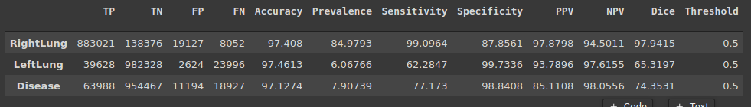
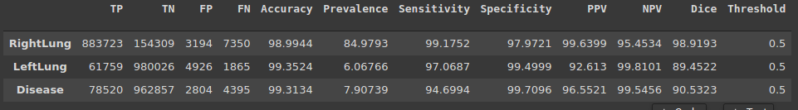
Evaluat [LinkNet]
Evaluat [U-net]
1
28

Slide 30
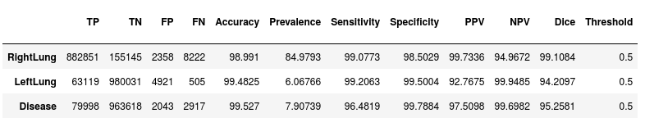
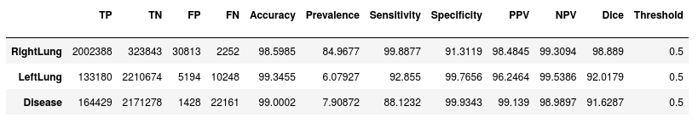
Evaluat [FPN]
Evaluat [PSPNet]
29

Slide 31
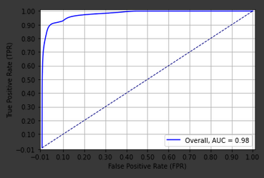
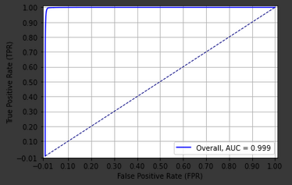
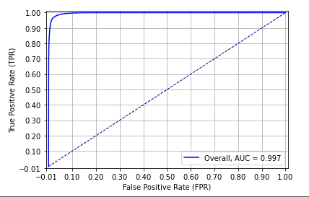
U-net
Linknet
ROC Curve :
PSPnet
FPN
30

Slide 32
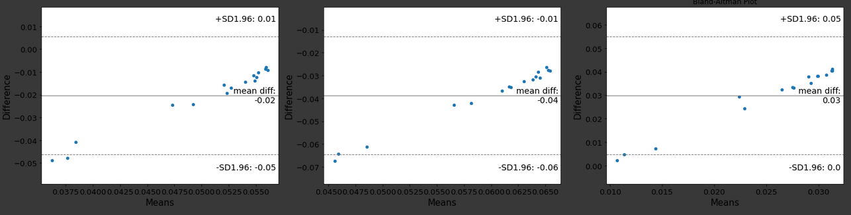
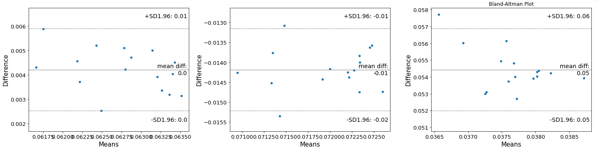
U-net
Link-net
Bland-Altman Plot:
31

Slide 33
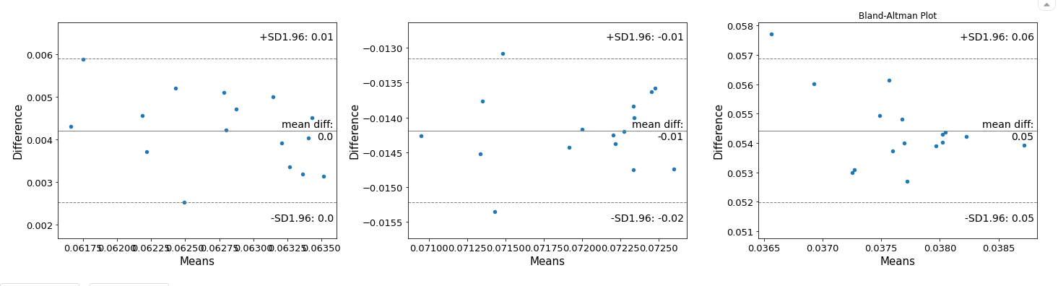
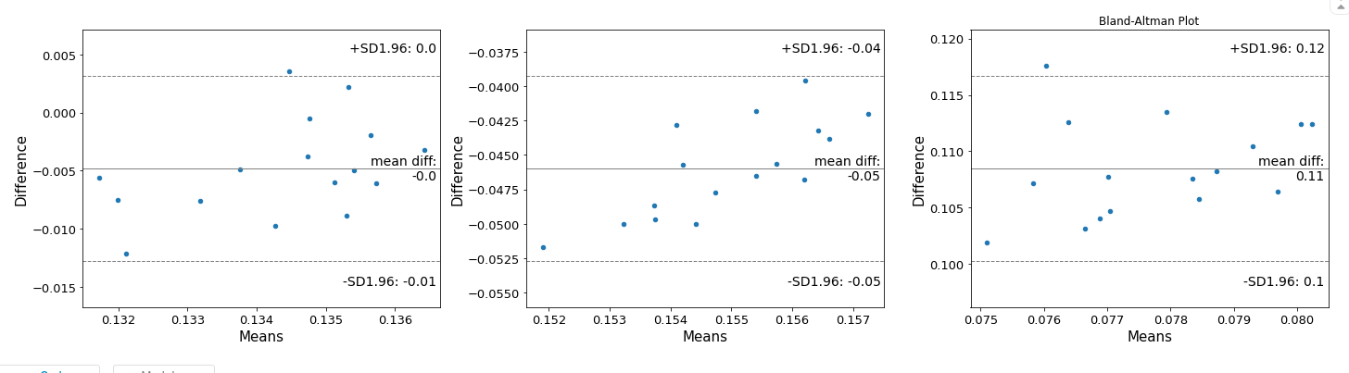
FPN
Bland-Altman Plot:
PSPnet
32

Slide 34
Hausdorff Distance
# images = 16
Pretrain models | HD | HD95
U-Net | ~10.5 - ~ 15.5 | ~8 - ~12
LinkNet
FPN
PSPNet
33

Slide 35
Conclusion:
In this project we mork on multiclass segmentation problem for CT images to segment [Left Lung, Right Lung and COVID-19].
Applied different model to solve this problem like [U-Net, LinkNet, FPN and PSPNet].
Evaluate the result using several method like [Dice, ROC, Hausdorff, Sensitivity and specificity, .. ].
34

Slide 36
Implementation:
Python
Keras
Tensorflow
Albumentations
Sklearn
Google Colab, Kaggle Notebooks: 1- [U-net] : https://colab.research.google.com/drive/1FkkU2wApXPvI977olGR3kiFIhyr3jj31#scrollTo=FQGCiOBT5BCP 2- [Linknet] : https://colab.research.google.com/drive/12_KTRu3o2TckyjMSGTRt0hVJEXuOVw7g#scrollTo=NkMbeYuwSwD6 3- [FPN] : https://colab.research.google.com/drive/1ZUR-cL6fWYv-D1ELxlpjAi4X9F7npIoE#scrollTo=Lr7OzGMzuDuZ 4- [PSPnet] :https://colab.research.google.com/drive/1w7dQ2TaA-w-B2461sXbWpN1RQcNsUz3k#scrollTo=rlxGm79W7mAK
35

Slide 37
References:
1- https://arxiv.org/pdf/1505.04597.pdf [U-Net: Convolutional Networks for Biomedical Image Segmentation]
2- https://arxiv.org/pdf/1707.03718.pdf [LinkNet: Exploiting Encoder Representations forEfficient Semantic Segmentation]
3- https://arxiv.org/pdf/1612.01105.pdf [Pyramid Scene Parsing Network (PSPNet)]
4-http://presentations.cocodataset.org/COCO17-Stuff-FAIR.pdf [Feature Pyramid Network (FPN)]
5- https://segmentation-models.readthedocs.io/en/latest/index.html
6- https://gitee.com/junma11/COVID-19-CT-Seg-Benchmark#2
7- http://medicalsegmentation.com/covid19/
8- https://github.com/EMIDEC-Challenge/Evaluation-metrics
36

Slide 38

THANK YOU FOR YOUR ATTENTION!

